Slide 1
Priestland Consulting Ltd
Capability Statement
April 2023

Slide 2
About Priestland Consulting
We are an independent, specialist
consultancy that supports clients on
Strategy
Technology
Change
for the built environment

Slide 3
About Priestland Consulting
Strategy
Technology
Change
Technology options appraisal
Process mapping & requirements
capture
Technology roadmaps
Innovation & technology audit
Technology procurement & training
Business
strategy
Change
management

Slide 4


About Priestland Consulting
We link ConstructTech start-ups and ‘old world’ companies who need their ideas and innovation
Asset owners, contractors & consultants
Construct-tech start-ups

Slide 5



About Priestland Consulting
We help start-ups accelerate their strategic and business development
journey, by supporting
Value propositions
Go-to-market strategies
Relationships/
introductions
in a very practical way.

Slide 6
Our capabilities and skills
3D visualisation
4D planning
Analytics
BIM / Digital Engineering
Building Management Systems (BMS)
Business cases
Business development
Change management
Circular economy
Concurrent engineering
Cost consulting software
Cost management
Cultural change
Customer experience mapping
Design for Manufacture and Assembly (DfMA)
Digital design processes
Digital twins
Factory fabrication and engineering
Innovation
Laser-based scanning
Planning and project controls
Procurement
Programme delivery
Programme implementation and risk
Simulation
Strategy
Technology development
Training
Value propositions
Visualisation

Slide 7






























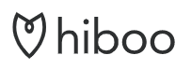


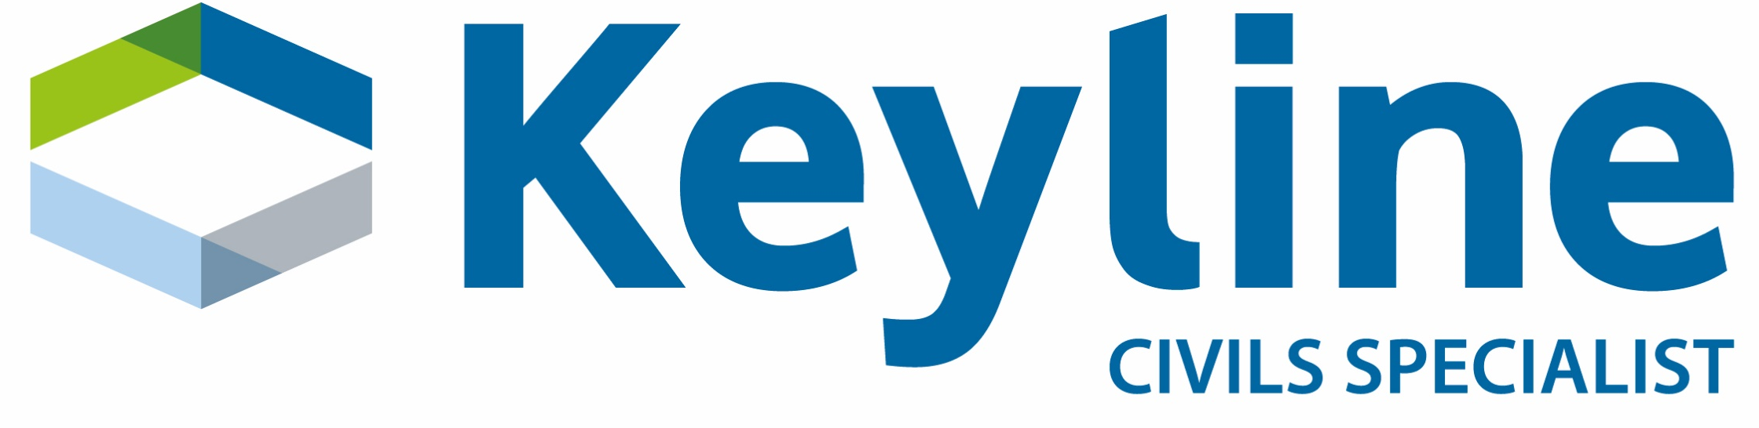






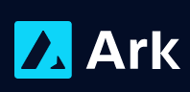

Our list of clients
We work with blue chip contractors and consultants, and transformational construction technology start-ups.
Asset owners
Contractors
Consultants
Start-ups
Others

Slide 8
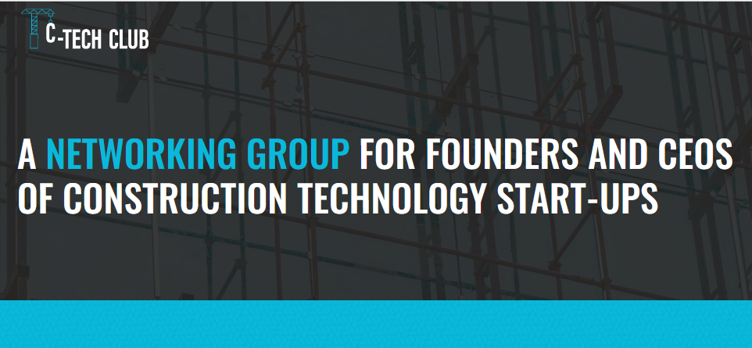

About the C-Tech Club
We have set up and support a networking group for founders and CEOs of construction tech start-ups – with 340 members in 28 countries.
www.c-techclub.org

Slide 9
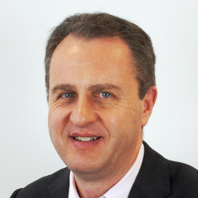
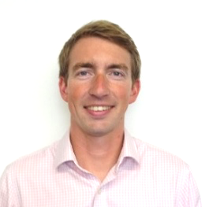
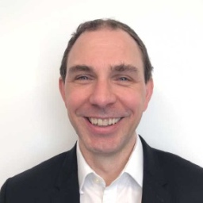
Our leadership team
John Priestland
Mike Turpin
Toby Chisnall
Managing Director
Technology Director
Change Management Director
John is a Director of Priestland Consulting and is advising contractors, utilities and consultants on digital innovation and the industrialisation of construction. Previously, he led digital transformation at AECOM from 2016 to 2018.
John was Global Strategy Director at WSP at the time of the acquisition of Parsons Brinckerhoff from Balfour Beatty. He has also held senior roles at Hyder Consulting and WS Atkins.
John has a MBA (with Distinction) from London Business School) and a First Class Degree in Physics from Keble College, Oxford. He is a Fellow of the Institution of Civil Engineering.
Mike is one of the UK’s leading experts on the implementation of BIM. Most recently, he was Head of BIM at Capita from 2014-17. As a consultant, he now advises clients on all aspects of BIM – from company strategy, policy and implementation through to technical standards, software adoption and training.
Mike is an ambassador of BIM in the UK, working with the UK BIM Alliance, CDBB, UK Dynamo User Group and South BIM Region.
Toby is a change management professional who develops, supports and delivers change and transformation programmes that provide tangible results for our clients.
He’s an MBA graduate with a substantial and successful track record in organisational change. Priding himself not just in developing transformative strategies but in working with people at all levels of an organisation to ensure plans are fully realised.
Toby led an award-winning team to deliver digital transformation for a leading UK housebuilder.

Slide 10
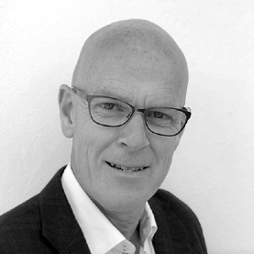
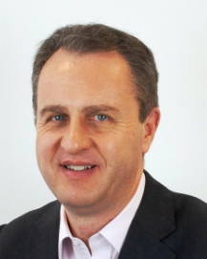
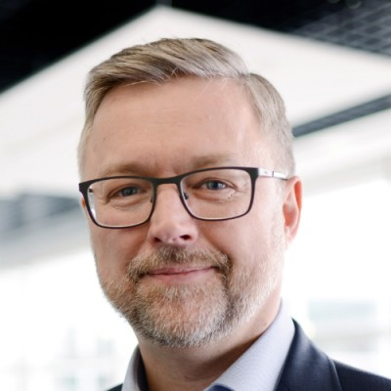
Our consultants
John Roberts
Richard Lane
Andrew “Rusty” Patterson
Digital design and construction engineer
BIM technical specialist
Highways Subject Matter Expert
Fee rate = £700 per day
John has worked as a technical integrator and collaborator at Arup, Atkins and Laing O’Rourke for 35 years; winning, designing, and delivering innovative products and projects.
Until 2020 he was a Director at contractor Laing O’Rourke as Project Technical Leader for several major projects, coordinating the design, manufacturing and digital supply chains.
John is a Fellow of the Institution of Civil Engineering and a steering committee member for the International Association of Bridge and Structural engineers.
Richard spent nearly 15 years at Autodesk before moving into strategy and change management, with particular expertise around BIM. He was the programme manager for the EU BIM Task Group, and is currently working with the Centre for Digital Built Britain in sharing the UK's experience on BIM and digital transformation of construction with governments across Europe, Latin America and Asia. Richard will act as a peer reviewer for the developing strategy, with a particular emphasis on the viability and connectivity of the technologies proposed. This will include the business case for its deployment.
Rusty has spent the last 30 years working within the highways sector, initially with Semple and Cochrane Ltd and then with Mway Communications Ltd, which he set up in 2001 and manged until selling the business in 2016.
Rusty has developed strategic relationships with manufacturers which made it possible to delivery higher quality products, improve the safety of the installation for the workforce, lessen the impact on the environment and deliver programme efficiencies.
Now working as a consultant Rusty is ideally placed to provide solutions to the practical challenges associated with the integration of new ideas and installation methods into the highways sector.

Slide 11
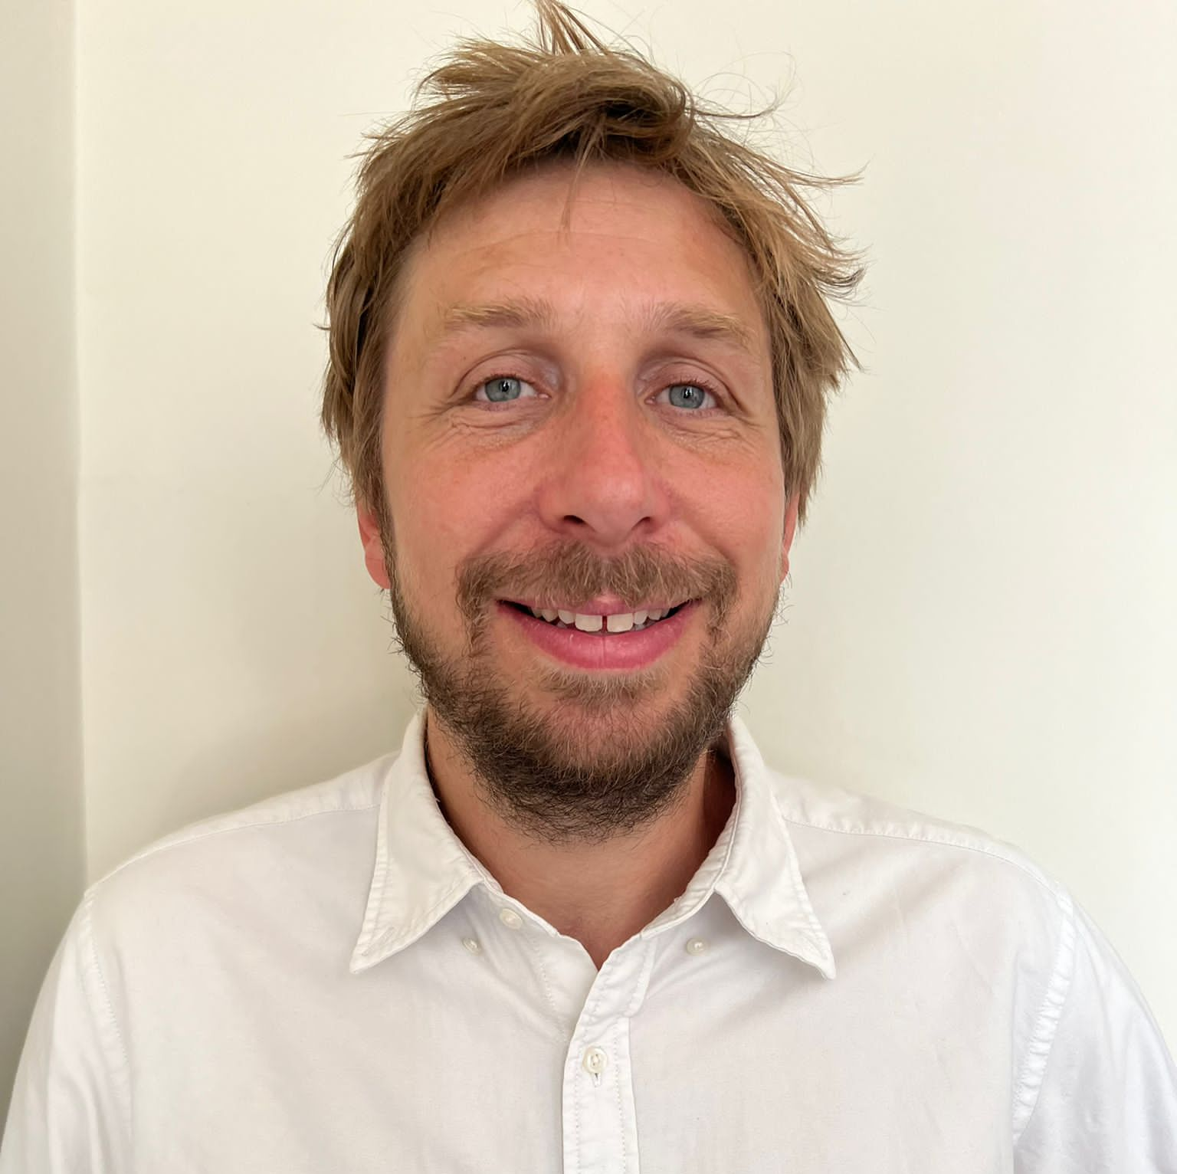
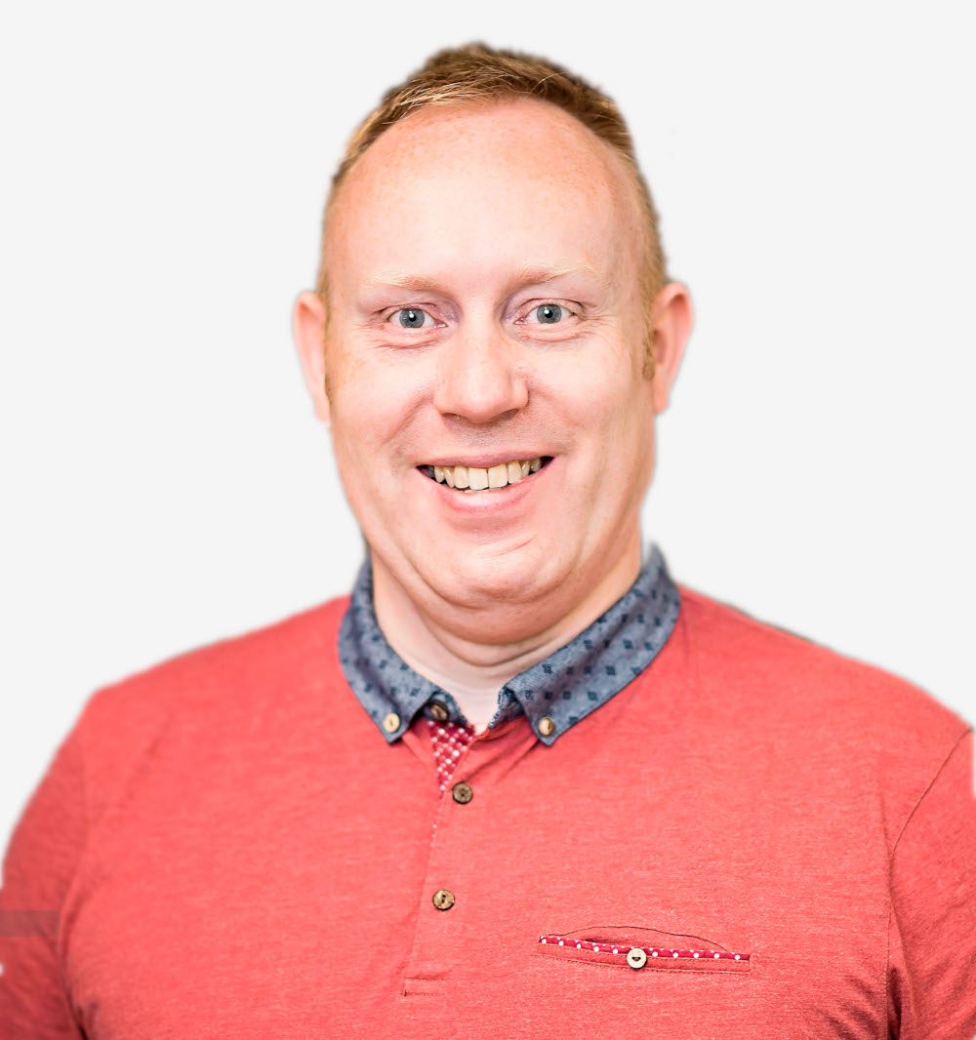
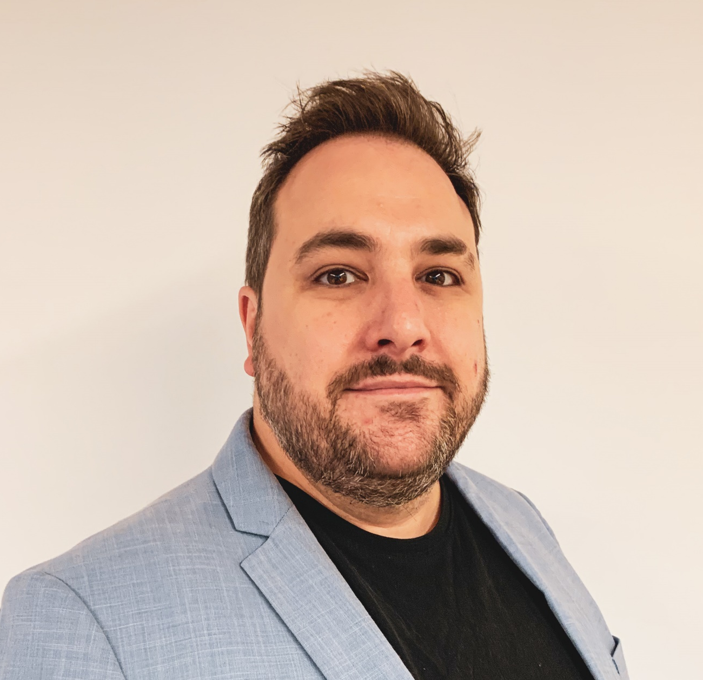
Our consultants
Tom Winslow
Nigel Pugh
Bevan Ross
Data Analyst
Technology/CTO Specialist
Lead consultant for Australia
Tom is a highly competent TOGAF certified lead data architect who is comfortable working at both enterprise and project levels. He has over 15 years of experience within the construction and information technology sectors, delivering large-scale system implementations, integrations and data modelling to support significant business transformations.
He led the development of the data platform for HS2, and advised on key systems integration challenges for this hugely complex programme. He has also worked for Immarsat, FirstGroup, property consultants Pick Everard, City&Guilds and the British Red Cross.
Nigel is an experienced technology leader with 20 years’ experience in managing distributed and offshore teams, scaling software engineering functions and building high-quality, high-output teams. He is a specialist in scaling cloud architectures, databases, IoT systems, high volume embedded systems, electronics design and manufacturing, and cybersecurity. He was Chief Technology Officer at Minibems and held senior technology/development roles at BetFair and “British Gas Hive”.
Bevan has extensive experience of innovation, first at Startrack (the parcel business of Australia Post) and then at BlueScope where he created a dynamic steel marketplace for builders and suppliers.
Since 2018, Bevan has acted as a consultant for property, supply chain and consultant clients. In this capacity, he has led technology reviews, change management, research and development, product architecture and business strategy. He has also helped set up two construction-tech start-ups that specialise in a BIM-enabled marketplace for steel fabricators – first IMANI and then Project BXM.

Slide 12
What people say about Priestland Consulting
"We enjoyed working with PCL - highly relevant advice and insight spanning the construction industry and tailored to suit
our needs"
Chris Bosworth, Group Strategy Director, Travis Perkins
“PCL know the design and construction world inside-out and are passionate about working with start-ups to help them get to market, find the right business model to unlock customers and quickly scale their revenues.
Matt Blythe, Co-Founder of Continuum Industries
“PCL supported us in making a big impact on strategy, bidding and technology. I recommend them wholeheartedly to other clients looking to develop their market thinking and implement change.”
Steve Helliwell, Chief Executive Balfour Beatty Living Places
“PCL know the design and construction world inside-out and are passionate about working with start-ups to help them get to market, find the right business model to unlock customers and quickly scale their revenues.
Matt Blythe, Co-Founder of Continuum Industries
“I would recommend PCL for advice, support and delivery especially around transformational change.“
Stephen Billingham, formerly Chairman of Anglian Water Group and non-executive director of Balfour Beatty plc
“The dedication shown in leading the project through to completion was refreshing. I have no hesitation in recommending PCL to others and would welcome the opportunity to work with them again.
Alistair Borthwick, CFO SSE Enterprise
“PCL delivered the project to high standards in an incredibly short timeframe. They really turned it around on a dime.”
Chantelle Ludski, CEO Anthesis North America

Slide 13
What people say about Priestland Consulting
“Priestland Consulting have worked with us for several years and have always been an excellent consultant partner. I really like working with people who deliver consistently high-quality work on time, always. ”
Ed McCann, Senior Director Expediiton Engineering and ICE Past President
"Working with Priestland Consulting has been nothing short of fantastic. Not only do they serve as a great strategic sounding board but they go out of their way to help provide a new start-up value in any way they can. Beyond that, they are a warm and friendly team to work with. “
Mo Shana’a, CEO, Morta.io
“PCL fielded an experienced team with a range of skills and abilities and a deep knowledge of the construction sector. Working with PCL allowed Highways England to develop the strategy more quickly and in greater depth than would otherwise have been possible”
Ken McCoard, Strategic Procurement Team, Highways England
“PCL know the design and construction world inside-out and are passionate about working with start-ups to help them get to market, find the right business model to unlock customers and quickly scale their revenues.
Matt Blythe, Co-Founder of Continuum Industries
"PCL’s guidance has helped us develop a solid strategy and the right relationships. I would highly recommend them to anyone who wants to get a good understanding and navigate the construction sector."
Rene Morkos, Founder and CEO of ALICE Technologies Inc
“PCL brought the knowledge, skills and independence we needed to help kick-start our digital twin programme with clear purpose and outcomes based thinking. I recommend them highly.”
James Crompton, Director of Anglian Water’s Strategic Pipeline Alliance (SPA)
“PCL were instrumental in helping us expand our UK client base, connecting us with important and industry-leading construction businesses. Their intros and insights really accelerated our growth to a level beyond our expectations."
Shane Hopkins, Founder and CEO of Matrak

Slide 14
Contact: John Priestland | Telephone: +44 (0)7990 081382 | Email: john@priestland.com | priestland.com

